Slide 1



Preferred Hotel Information
2026 Alberta Artistic Swimming Development Conference & Camp

Slide 2
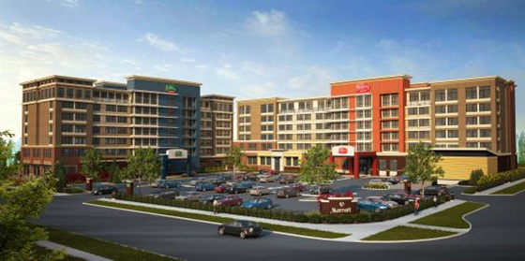
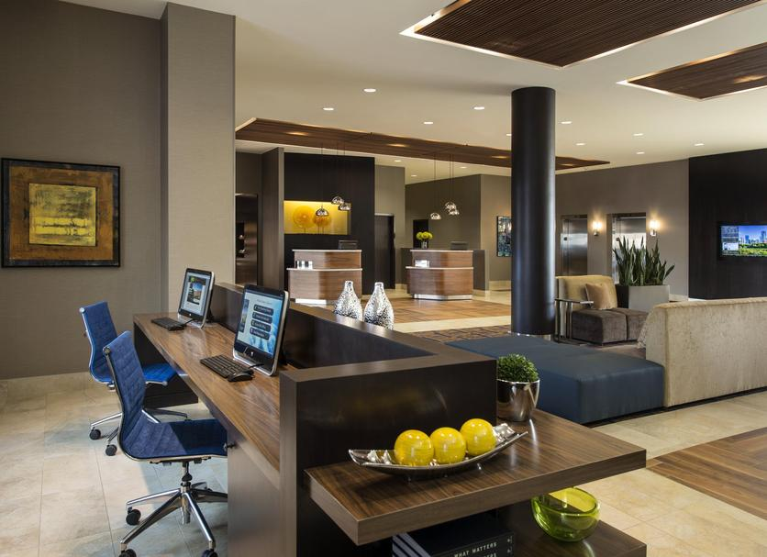

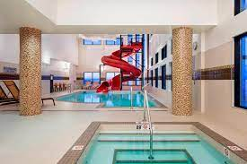

Courtyard/Residence Inn by Marriott Calgary South
3750 Market Street SE
Calgary, AB T3M 2P2
Tel: 587-349-7599
Courtyard by Marriott Calgary South
Distance to YMCA Seton: 1 Km / 4 minutes
Distance to Calgary International Airport: 39 Km / 34 mins
Guestroom Rates:
Standard 2 Queen Room (sleeps 4): $195 s/d
Large 2 Queen Room with sofa bed (Sleeps 5): $209 s/d
Taxes & Fees: 17.66%
(subject to applicable taxes/fee at check-out)
Booking Rooms: Individuals can call 587-349-7599 and quote group name “Alberta Artistic Swimming” .
All reservations must be accompanied by a first night room deposit or guaranteed with a major credit card.
Information:
Rates include Full Hot Buffet Breakfast daily
Complimentary Parking
Indoor Heated Pool & Fitness Centre
Individual Cancellations: 72 hours prior to arrival. Late cancellations will result in 1 night room and tax charged to individual credit card. “All reservations must be accompanied by a first night room deposit or guaranteed with a major credit card.”
Group Cut off Date: September 2, 2026

Slide 3

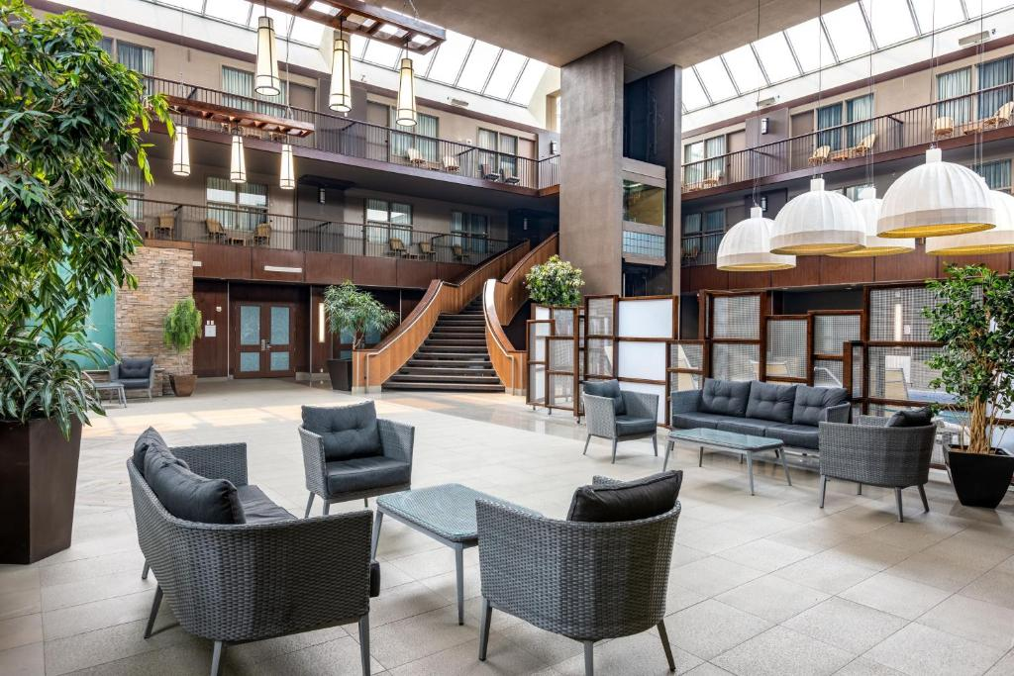
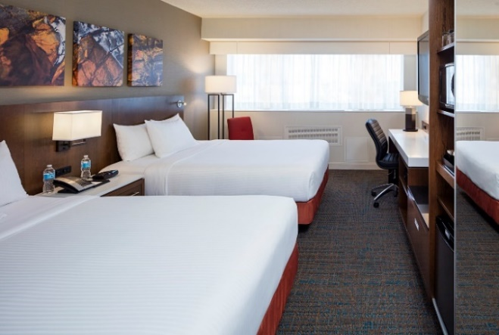

Delta Hotels by Marriott Calgary South
135 Southland Drive SE
Calgary, AB T2J 5X5
403-278-5050
Delta South Site
Distance to YMCA Seton: 17.1 Km / 18 mins
Distance to Calgary International Airport: 28 Km / 28 mins
Guest Room Rates:
Standard 2 Queens: $169.00 s/q
Taxes & Fees: 17.66%
(subject to change without notice)
Booking Rooms: Reservations for the Event will be made by the individual directly on ResLink. Or by calling 403-278-5050 and Reference the ASA Development Conference and Camp.
Book Using the Group Rate Here
All reservations must be accompanied by a first night room deposit or guaranteed with a major credit card.
Information:
Breakfast for 2 Included; $11 / additional voucher
Complimentary High-Speed Internet
Complimentary Parking
Pool & Fitness Centre
Individual Cancellations: 48 hours prior to arrival. Late cancellations will result in 1 night room and tax charged to individual credit card.
Group Cut off Date: September 11, 2026

